Slide 1

Web based Movie Theatre Management
using Python
By
Shubham Patil (22106047)
Aniruddha Pawar (22106009)
Manasi Patil (22106042)
Project Guide
Prof. Mahesh Pawaskar

Slide 2
OUTLINE
Introduction
Literature Survey of the existing systems
Limitations of the existing systems
Problem statement
System Design
Technologies and Methodologies
Implementation
Conclusion
References

Slide 3
INTRODUCTION
A movie theater management system is an online platform created to streamline theater operations.
The primary purpose of our system is to provide another way for customers to buy a cinema ticket.
A web-based movie theatre management system, driven by a robust database, is necessary for seamless operations and an enhanced cinema experience.
The system employs SQLite as a database, while Django functions as a web framework for building web applications.

Slide 4
Movie theatres and cinemas, as well as customers seeking convenient online services, are the primary users of this system.
Empowering administrators and patrons with efficient scheduling, ticketing, pricing, and user-friendly features while facilitating streamlined data management and revenue monitoring.
Through the online platform, moviegoers can conveniently browse movie schedules, purchase tickets, and select seats, providing them with a more convenient and enjoyable experience.
The system can provide real-time updates on ticket availability, showtimes, and seating arrangements, helping theaters and customers make informed decisions.

Slide 5
LITERATURE SURVEY OF THE EXISTING SYSTEM
Leading online movie ticket platforms like BookMyShow, Ticketplease.com, and Fandango dominate the market with secure payment processing, seat reservation, and convenient movie information, surpassing traditional manual methods.
Existing solutions use PHP for user-friendly front-end interfaces, SQL Server for reliable database management, and often employ C for dynamic web page development, ensuring a seamless user experience.
Current online movie ticket systems encounter issues like server overload, payment glitches, security concerns, and limited information, necessitating enhanced, user-friendly solutions.
Users seek a smooth, secure online movie ticketing experience with improved features and comprehensive movie details for enhanced accessibility and flexibility.

Slide 6
LIMITATIONS OF THE
EXISTING SYSTEMS
The focus on technical aspects and features, without a thorough examination of user feedback or market acceptance, raises concerns about the real-world viability and success of the implemented system.
Challenges include system limitations in handling last-minute cancellations, limited theater partnerships, technological barriers for users with limited access, and transaction fees imposed by some platforms.
The absence of insights into security measures, scalability challenges, and user interface issues further limits the depth of the survey.
The survey's small sample size, specific geographical focus, and reliance on self-reported data contribute to potential biases, reducing the generalizability of the findings.

Slide 7
PROBLEM STATEMENT
Before the advent of a Movie Theatre Management System via a website, manual administration posed challenges such as time-consuming scheduling, ticket sales, and revenue tracking.
Paper-based systems resulted in errors and disorganized customer booking records.
The lack of a centralized system hindered real-time insights into theatre performance and customer feedback, prompting the development of a web-based solution for efficient and automated theatre management.

Slide 8
SYSTEM DESIGN

Slide 9
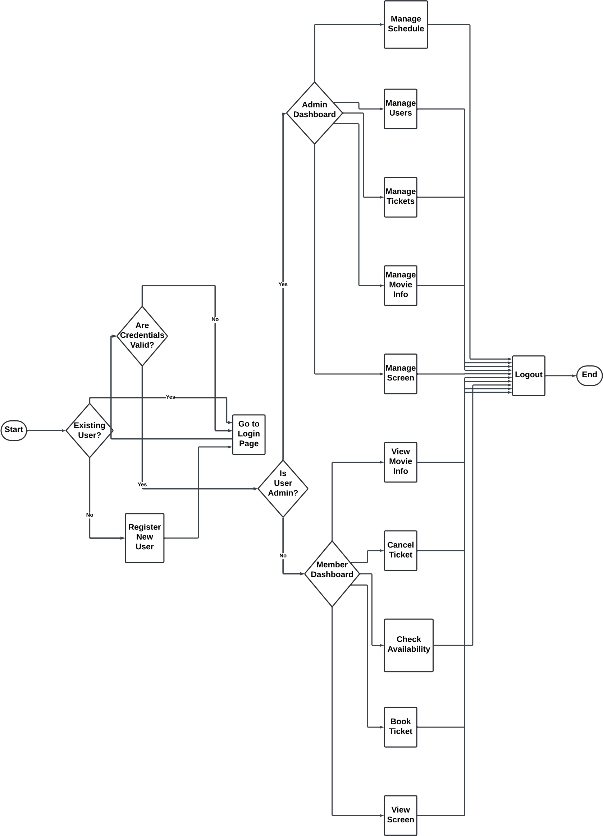

Slide 10
TECHNOLOGIES AND METHODOLOGIES
Python is chosen as the primary programming language
JavaScript is selected for frontend development
Django is utilized as a backend framework in the website and also utilized for developing the web-based application.
SQLite is used for managing and storing data on the backend in the website.

Slide 11
IMPLEMENTATION

Slide 12
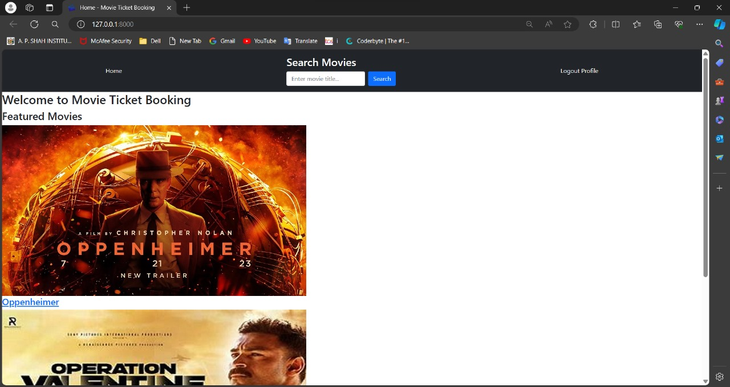

Slide 13
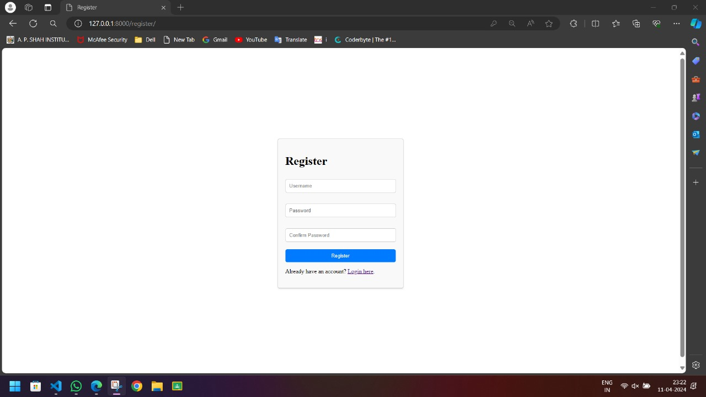

Slide 14
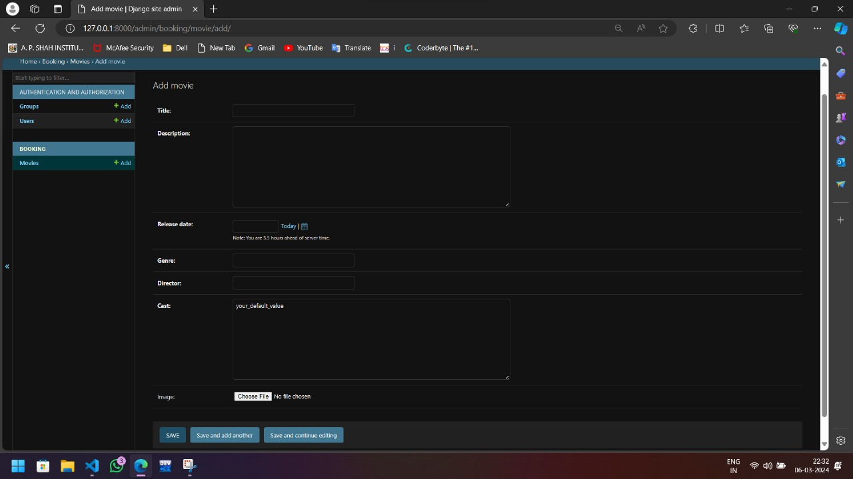

Slide 15
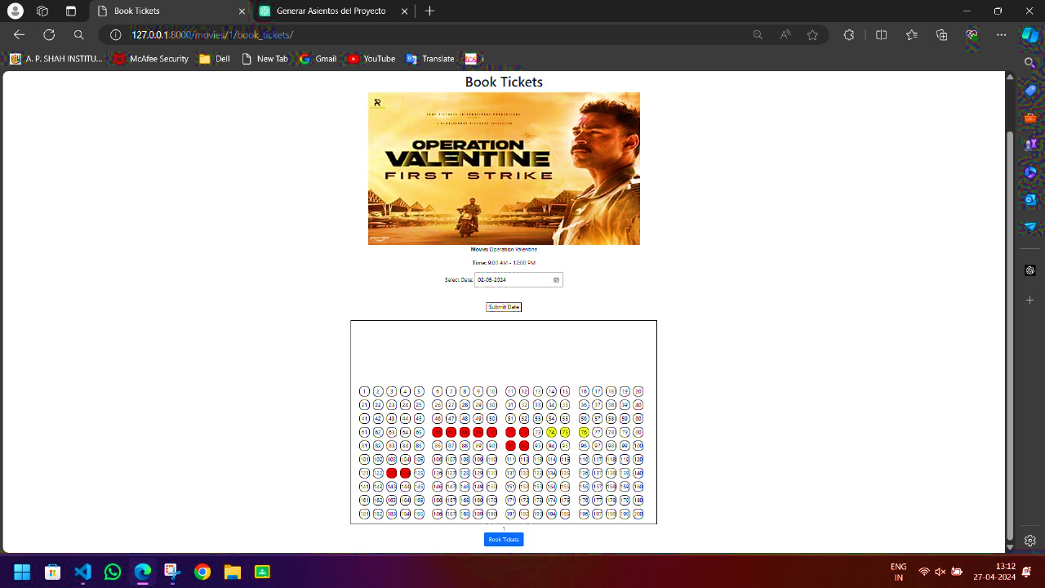

Slide 16
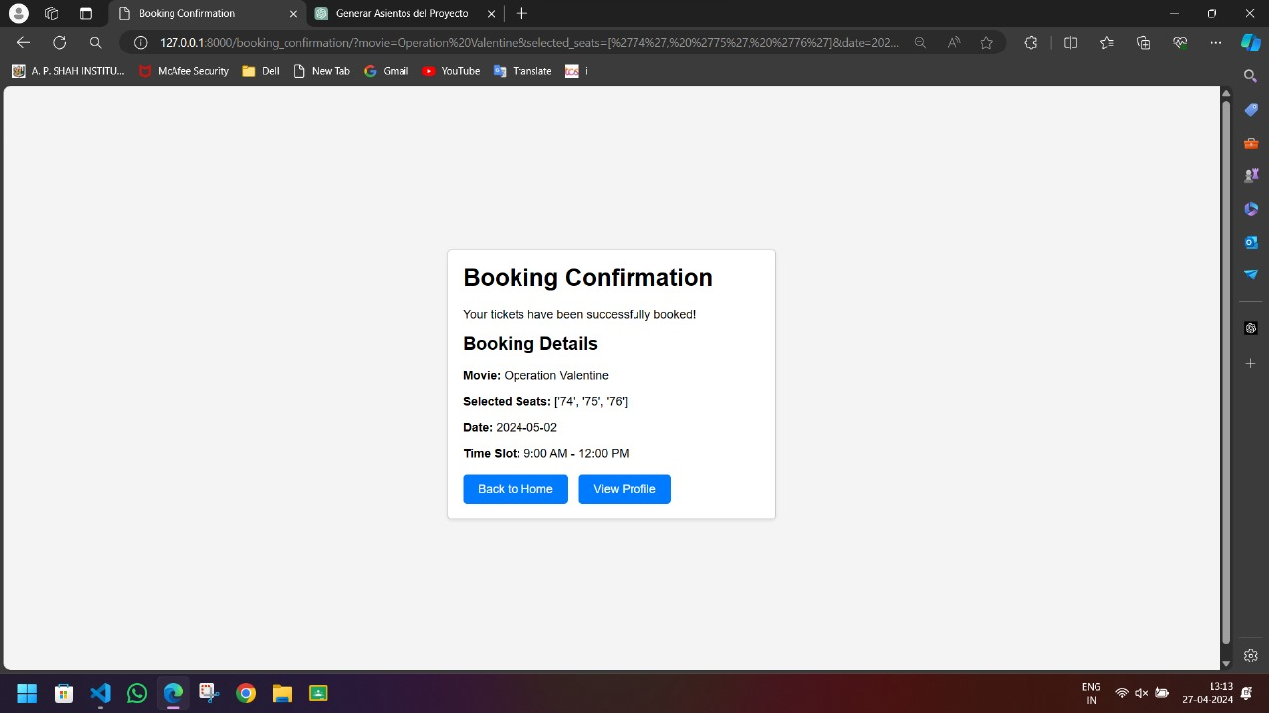

Slide 17
CONCLUSION
The literature on the Web-based Movie Theatre Management System has undergone a comprehensive examination.
The administration and user interface has been successfully implemented, completing this phase of the project.
Additionally, the implementation of the interface for patrons and administrator is also completed.
The user interface is slated for enhancement to ensure a more user-friendly experience.

Slide 18
REFERENCES

Slide 19
[1] “A Cinema - Online Movie Ticket Booking System” by Aarya Nanndaann Singh M N, Akash Hegde P, Abhilash R, Akash Kumar, Prof. Priyadarshini R Volume 9, Issue 2, Mar-Apr-2023.
[2] “A New approach for online movie ticket booking System” by Arjun Kumar Mishra, Shashank Gupta, Rajeev Kumar JETIR May 2022, Volume 9, Issue 5.
[3] “A Project on Online Ticket Booking System” by Punyaslok Sarkar, Mrs Sherly Noel, Internation Research Journal of Engineering and Technology (IRJET), Volume: 07, Issue: 05, May 2020.
[4] “Consumers’ Predilection towards Online Movie Ticket Booking System (With reference to bookmyshow.com in Davangere city)” by Punith Kumar.D.G and Pooja.K.M.B, Studies in Indian Place Names (UGC CARE Journal) ISSN: 2394-3114Vol-40, Special Issue-25, March 2020.
[5] “Design and Implementation of a Movie Reservation System” by John Bosco, Caleb Chibuikem Victor, Ayangbekun Oluwafemi J.*& Ntiaya Epse Tuma International Journal of Computer Techniques -– Volume 6 Issue 4,August 2019.
[6] “A Comparative Study in Online Movie Ticket Booking System” by Archit Roy, Vinit Shahdeo, Rajesh Kaluri Published In: Volume - 10, Issue - 1, Year – 2019.

Slide 20
THANK YOU

